Slide 1

Ace of Hearts
Mia Giandinoto, Hannah Hagenau, Anna Johnson, Shivani Kulkarni, Dhruv Modi, Sherina Thomas, Matthew Tran
November 22ndh, 2020

Slide 2
Constraints
One team member at a distance that made collaboration more difficult
Unreliable batteries for a limited cost
Computer difficulties impeding the neural network

Slide 3
Signal Measurement
Unstressed (baseline)
 | Subject 1 | Subject 2
Test 1 | 3.902 | 4.008
Test 2 | 3.889 | 4.016
Test 3 | 3.882 | 4.024
For each subject:
Collected 3 baseline readings
Collected 3 stressed readings
Stressors: Timed typing test (mild) and auditory multiplication test (moderate)
Stressed
 | Subject 1-mild | Subject 2-moderate
Test 1 | 4.687 | 7.169
Test 2 | 4.332 | 5.968
Test 3 | 5.414 | 6.124

Slide 4
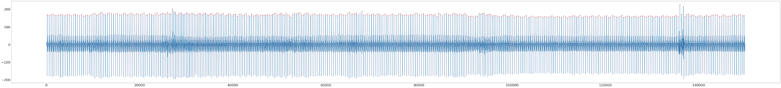
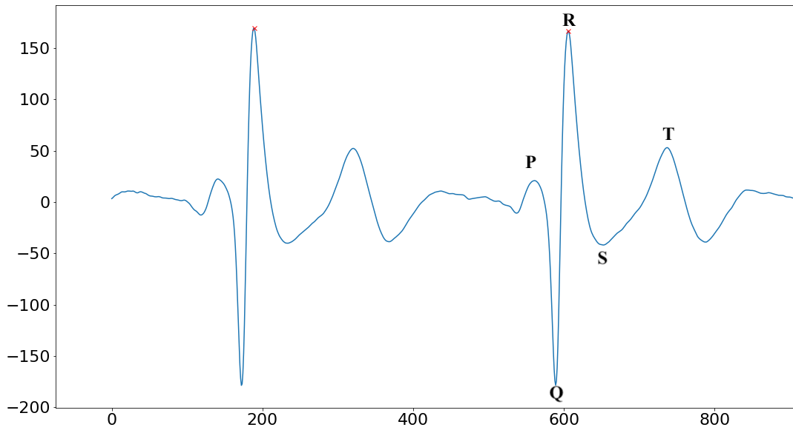
Signal Analysis

Slide 5
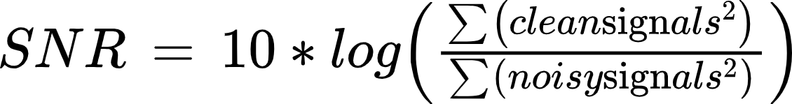
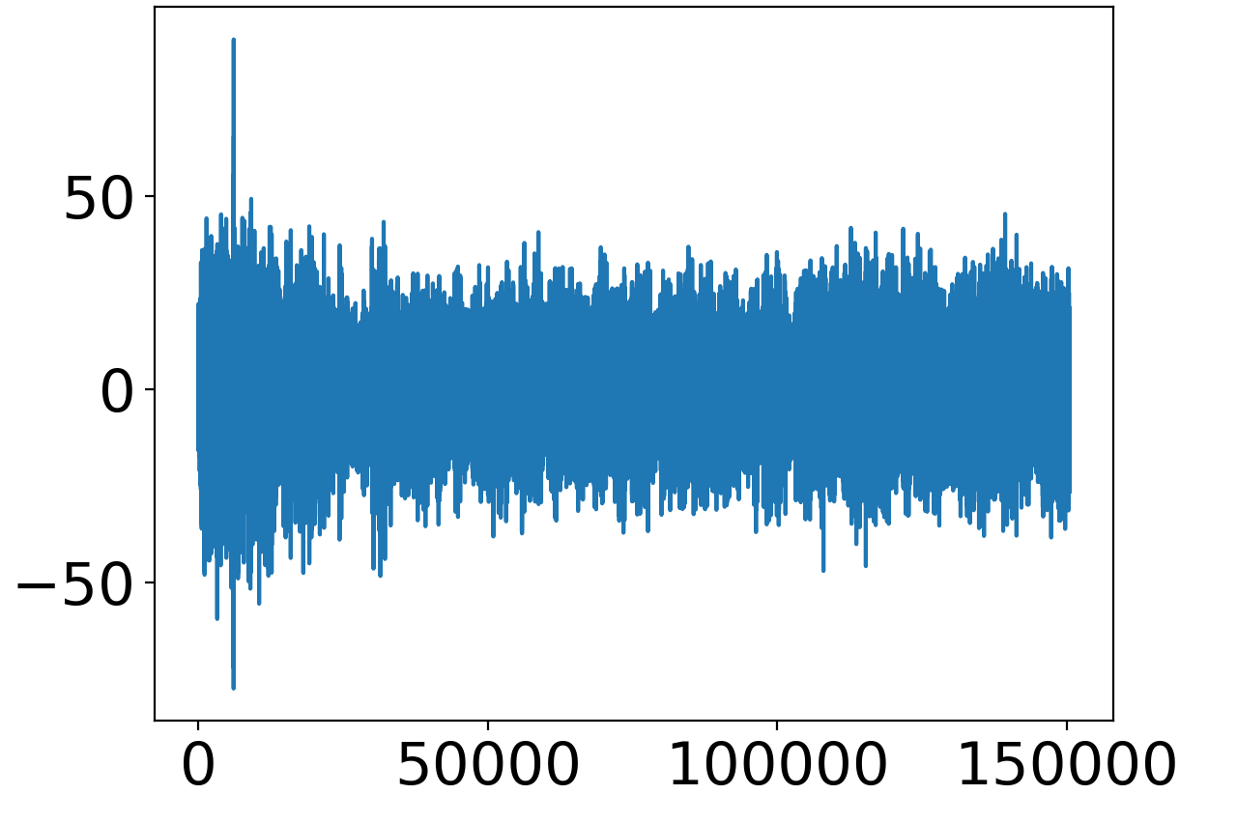
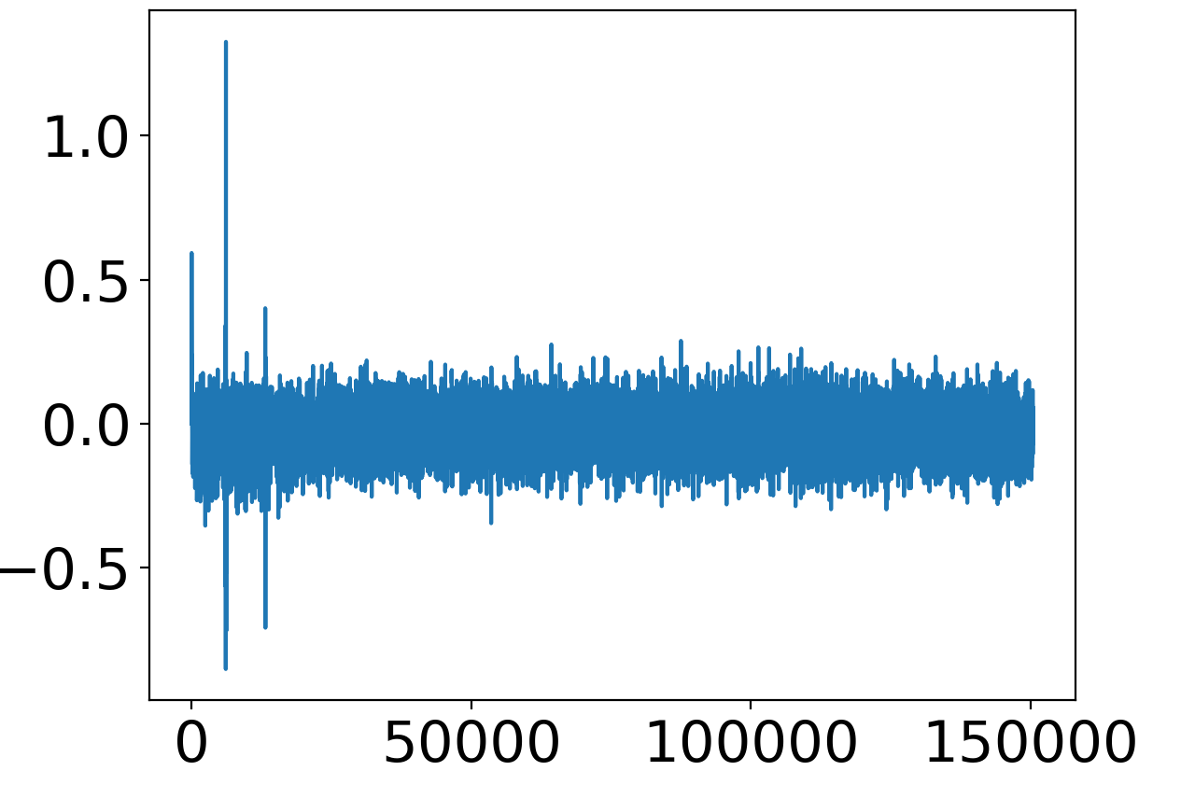
Pure Device Noise
Connected leads via resistors
Signal to Noise Ratio: -94.9089
Determines filter effectiveness
Unfiltered Signal (noisy)
Filtered Signal
(clean)

Slide 6
Decision Criteria
Overall Categories
 | Accuracy | Reliability | Time Sensitivity | Cost
Subcategories | Correct R-peaks HRV reading | Consistent signal output Environmental consistency | Quick enough results for effective diagnosis | Device parts Electrodes
Weight | 0.25 | 0.25 | 0.20 | 0.10

Slide 7
Accuracy - R peaks
Recording | Number of R Peaks | Missed Peaks | Extra Peaks
1 | 364 | 0 | 0
2 | 366 | 0 | 0
3 | 381 | 0 | 0
4 | 374 | 5 | 0
5 | 380 | 0 | 0
6 | 408 | 0 | 0
7 | 376 | 0 | 0
8 | 388 | 0 | 0

Slide 8
Recording | LF/HF ratio | Applied Stress | Detected Stress | Correct Signal Interpretation
1 | 3.902 | No | No | True
2 | 3.889 | No | No | True
3 | 3.882 | No | No | True
4 | 4.008 | No | No | True
5 | 4.016 | No | No | True
6 | 4.024 | No | No | True
7 | 4.687 | Yes | Yes | True
8 | 4.332 | Yes | Yes | True
9 | 5.414 | Yes | Yes | True
10 | 7.169 | Yes | Yes | True
11 | 5.968 | Yes | Yes | True
12 | 6.124 | Yes | Yes | True

Slide 9
Reliability
Consistent Signal Output (5/5)
Baseline readings consistent across tests
Environmental Consistency (5/5)
Readings taken in different areas give similar outputs
 | Subject 1 |  | Subject 2
Test | LF/HF ratio | % Deviation from mean | LF/HF Ratio | % Deviation from mean
1 | 3.902 | 0.3% | 4.008 | 0.2%
2 | 3.886 | 0.1% | 4.016 | 0%
3 | 3.882 | 0.2% | 4.024 | 0.2%

Slide 10
Time Sensitivity
Minimum accurate sampling period utilized for HRV reading
Low code processing time interval
Sample Reading Period | Time for Code Processing
5 minutes | 5-6 seconds
To minimize time and energy spent by the user on the device, we plan to include a simple bluetooth alert sent to their phone either stating ‘stressed’ or ‘not stressed’.
Removes need for user interpretation of readings
Stress reading equates to more than 3 standard deviations in LF/HF ratio from baseline readings

Slide 11
Cost/Value
Itemized Device Cost
*Future device component
Item | Cost
PCB* | $0.50
Resistors (x16) | $0.16
Op-amps (x2) | $0.75
Headphone Jack | $1.25
Electrodes (one week supply) | $2.10
Bluetooth Module* | $7.50
Total | $12.26

Slide 12
Decision Matrix
Criteria | Weight | Rating (Out of 5) | Score
Accuracy | .35 | 4.5 | 1.575
Reliability | .35 | 5 | 1.75
Time Sensitivity | .20 | 5 | 1
Cost | .10 | 4 | .4
Total Score | 1 | 18.5 | 4.725
Notes:
More slides or less words

Slide 13
Feasibility
For Prototype:
Mobility | Removing errors caused by movement More mobile hardware configuration
Power Supply | Addition of a consistent power supply
Neural Network | Time for training

Slide 14
Anticipated Difficulties
For Mobility:
Electrodes are sensitive and therefore easily affected by movement. Removing this noise can be difficult due to its unpredictability.
Surmountability: Yes, we have read literature where this is done. However, this would involve adaptive filtering and other components, which would increase the cost of the device.
For Power Supply:
The power supply needs to be mobile while also being able to last all day. This means that our device would require a strong battery.
Surmountability: Yes, a strong enough battery just needs to be acquired.
For Neural Network:
There were some difficulties in the training of our neural network for MI detection. It is extremely time consuming.
Surmountability: Yes, given enough time and better computers a neural network is plausible.

Slide 15
Value Proposition
We are creating value for our population of underinsured patients over the age of 45 at risk for a myocardial infarction, through reducing fatality by alerting patients and/or their caretakers when their stress levels are high, or they are actively having a heart attack, allowing for earlier treatment.
Ability to see value | What have we learned?
The value is clear because for patients at risk for an AMI, management of stress level can have preventative effects. | Our populations suffers from risk factors at the same rate as insured patients, but are less likely to control risk due to a lack of access to healthcare.
Notes:
https://www.ncbi.nlm.nih.gov/pmc/articles/PMC2913281/

Slide 16
Innovation
While there have been various scientific studies that have used the HRV metric of LF/HF ratio to track stress, we have not come across a commercially available device that allows a user to take their own HRV readings in order to reliably track stress.
Reasons:
No user interpretation of readings required
User can track stress consistently with minimal effort
Portable device that is cost effective
Real-time analysis for any HRV metric

Slide 17
References
Differential Amplifier - The Voltage Subtractor. (2020, March 17). Retrieved November 11, 2020, from https://www.electronics-tutorials.ws/opamp/opamp_5.html
Harden, S. W. (n.d.). DIY ECG with 1 op-amp. Retrieved November 11, 2020, from https://swharden.com/blog/2016-08-08-diy-ecg-with-1-op-amp/
Kim, H.-G., et al. (2018). "Stress and Heart Rate Variability: A Meta-Analysis and Review of the Literature." Psychiatry Investigation 15(3): 235-245.
Moody GB, Muldrow WE, Mark RG(1984). “A noise stress test for arrhythmia detectors.” Computers in Cardiology 11:381-384.
Nunan, D., et al. (2010). "A Quantitative Systematic Review of Normal Values for Short-Term Heart Rate Variability in Healthy Adults." Pacing and Clinical Electrophysiology 33(11): 1407-1417.
Villegas, A., Mceneaney, D., & Escalona, O. (2019). Arm-ECG Wireless Sensor System for Wearable Long-Term Surveillance of Heart Arrhythmias. Electronics, 8(11), 1300. doi:10.3390/electronics8111300
Shaffer, F. and J. P. Ginsberg (2017). "An Overview of Heart Rate Variability Metrics and Norms." Frontiers in public health 5: 258-258.

Slide 18
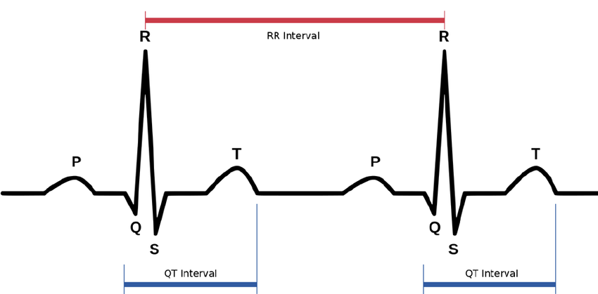
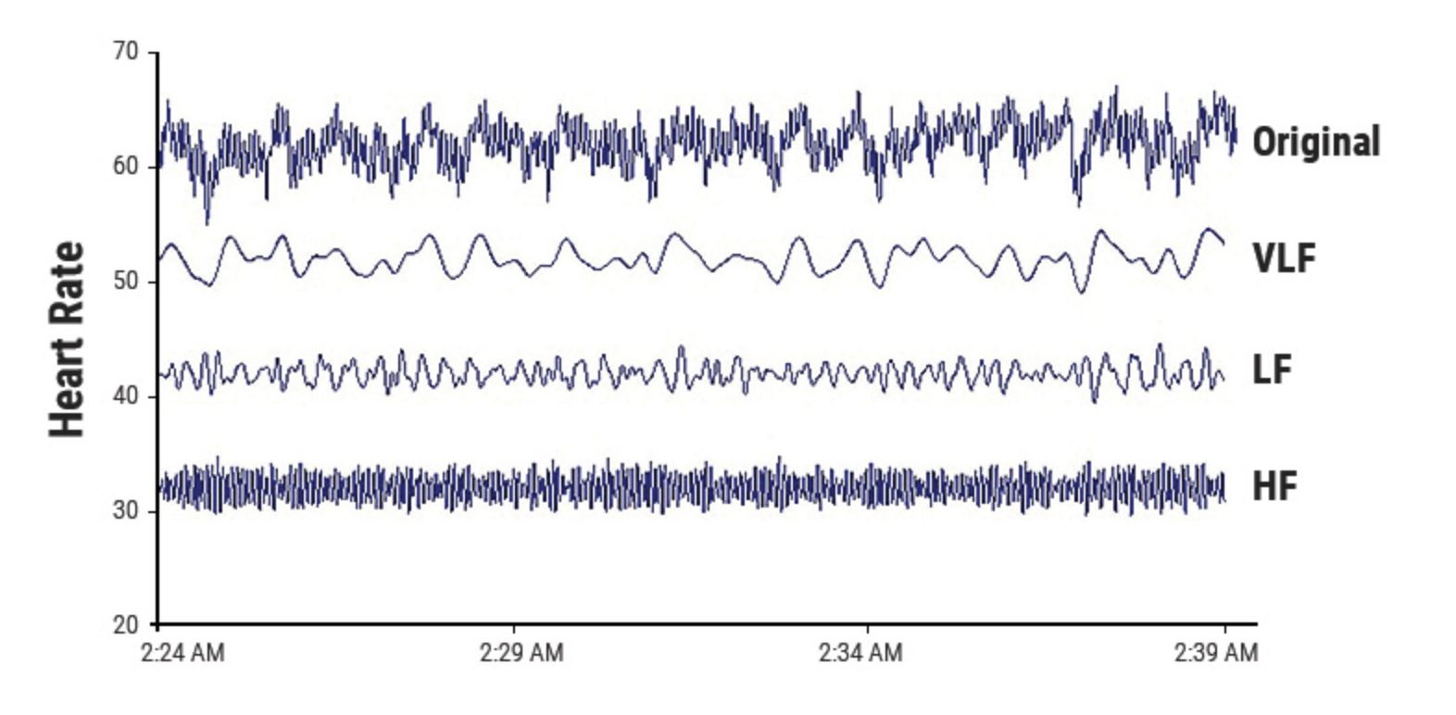
HRV Supplemental
ECG→R peak detection→ RR Intervals → Tachogram→ FFT and Power Spectral analysis→ Analysis
LF ranges from 0.04-0.15 Hz⁷
PNS, SNS, and BP regulation
HF ranges from 0.15-0.4 Hz⁷
parasympathetic/respiratory activity
Low power reflects stress
LF/HF Ratio
Reflects balance between SNS and PNS⁷
Increase in LF/HF ratio associated with high levels of stress(5 min recordings)³
Power Spectral Analysis to determine LF and HF power
https://www.physiospot.com/research/why-physical-therapists-can-use-heart-rate-variability-hrv-as-a-measurement-tool/

